Slide 1
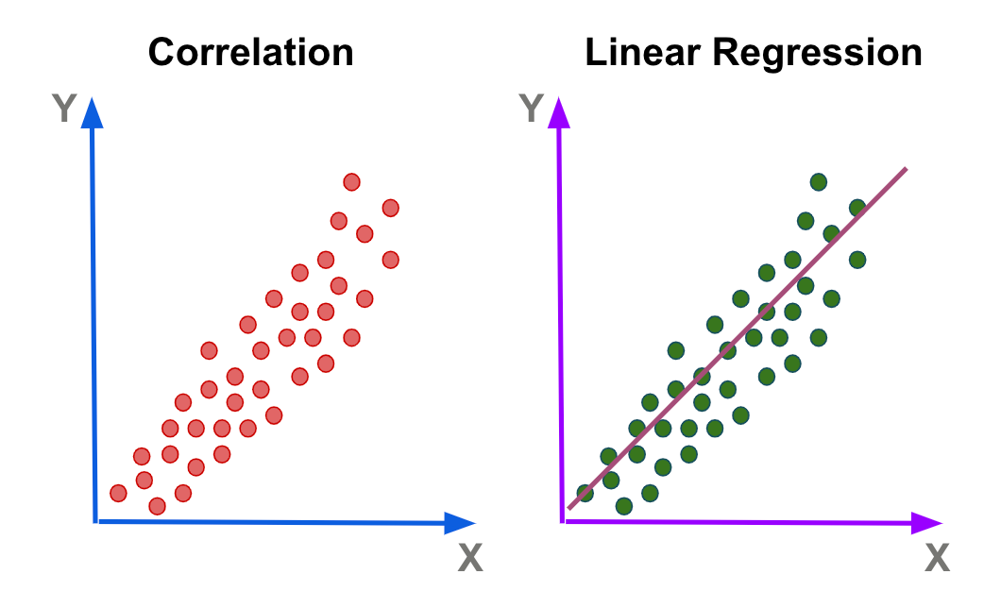
Linear Regression?
Linear Regression is a supervised machine learning algorithm used for predicting a continuous value (like price, salary, temperature) based on the relationship between input variables (X) and an output variable (Y).
It tries to find the best-fit straight line (called the regression line) that describes how input variables affect the output.
X1 | X2 | Y
20 | 30 | 1000
30 | 40 | 3000

Slide 2
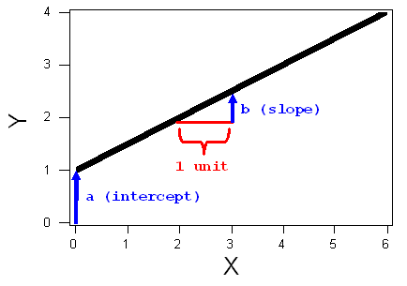
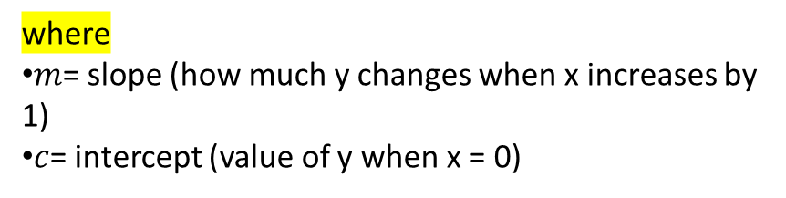
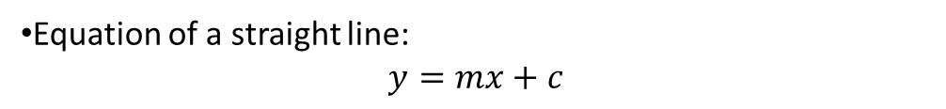
Mathematical Intuition
Equation of a straight line:
$$y=mx+c$$
where
$m$= slope (how much y changes when x increases by 1)
$c$= intercept (value of y when x = 0)

Slide 3
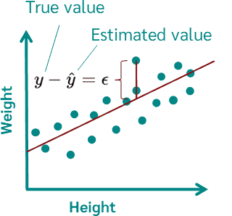
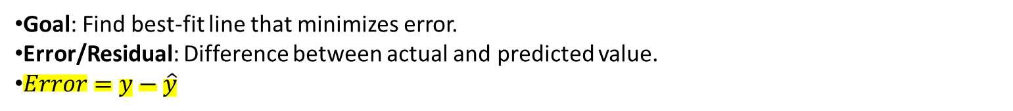
3. How It Works (Algorithm Concept)
Goal: Find best-fit line that minimizes error.
Error/Residual: Difference between actual and predicted value.
$Error=y−\hat{y}$

Slide 4
Types
Simple Linear Regression (1 feature)
Z = mx + c
Multiple Linear Regression (many features)
Z = mx1 + mx2 + mx3 + c
Exp (X) | (Price) Y
2 years | $3k
5 Years | $10k
10 years | $30k
Exp (X1) | Gender (X3) | Age (X3) | Price (Y)
2 years | Male | 22 | $2k
5 Years | Female | 50 | $12k
10 Years | Male | 45 | $30k

Slide 5
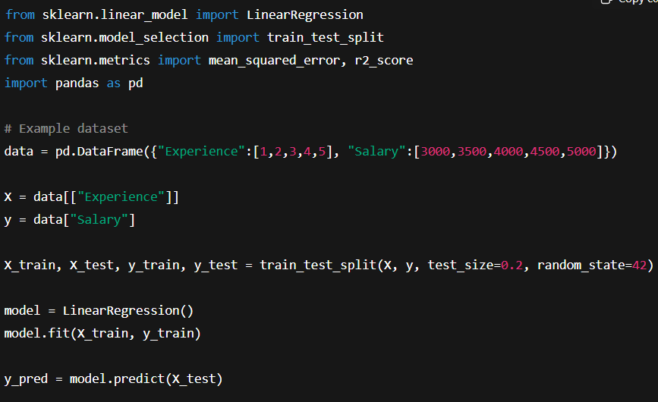

Code Implementation

